Slide 1

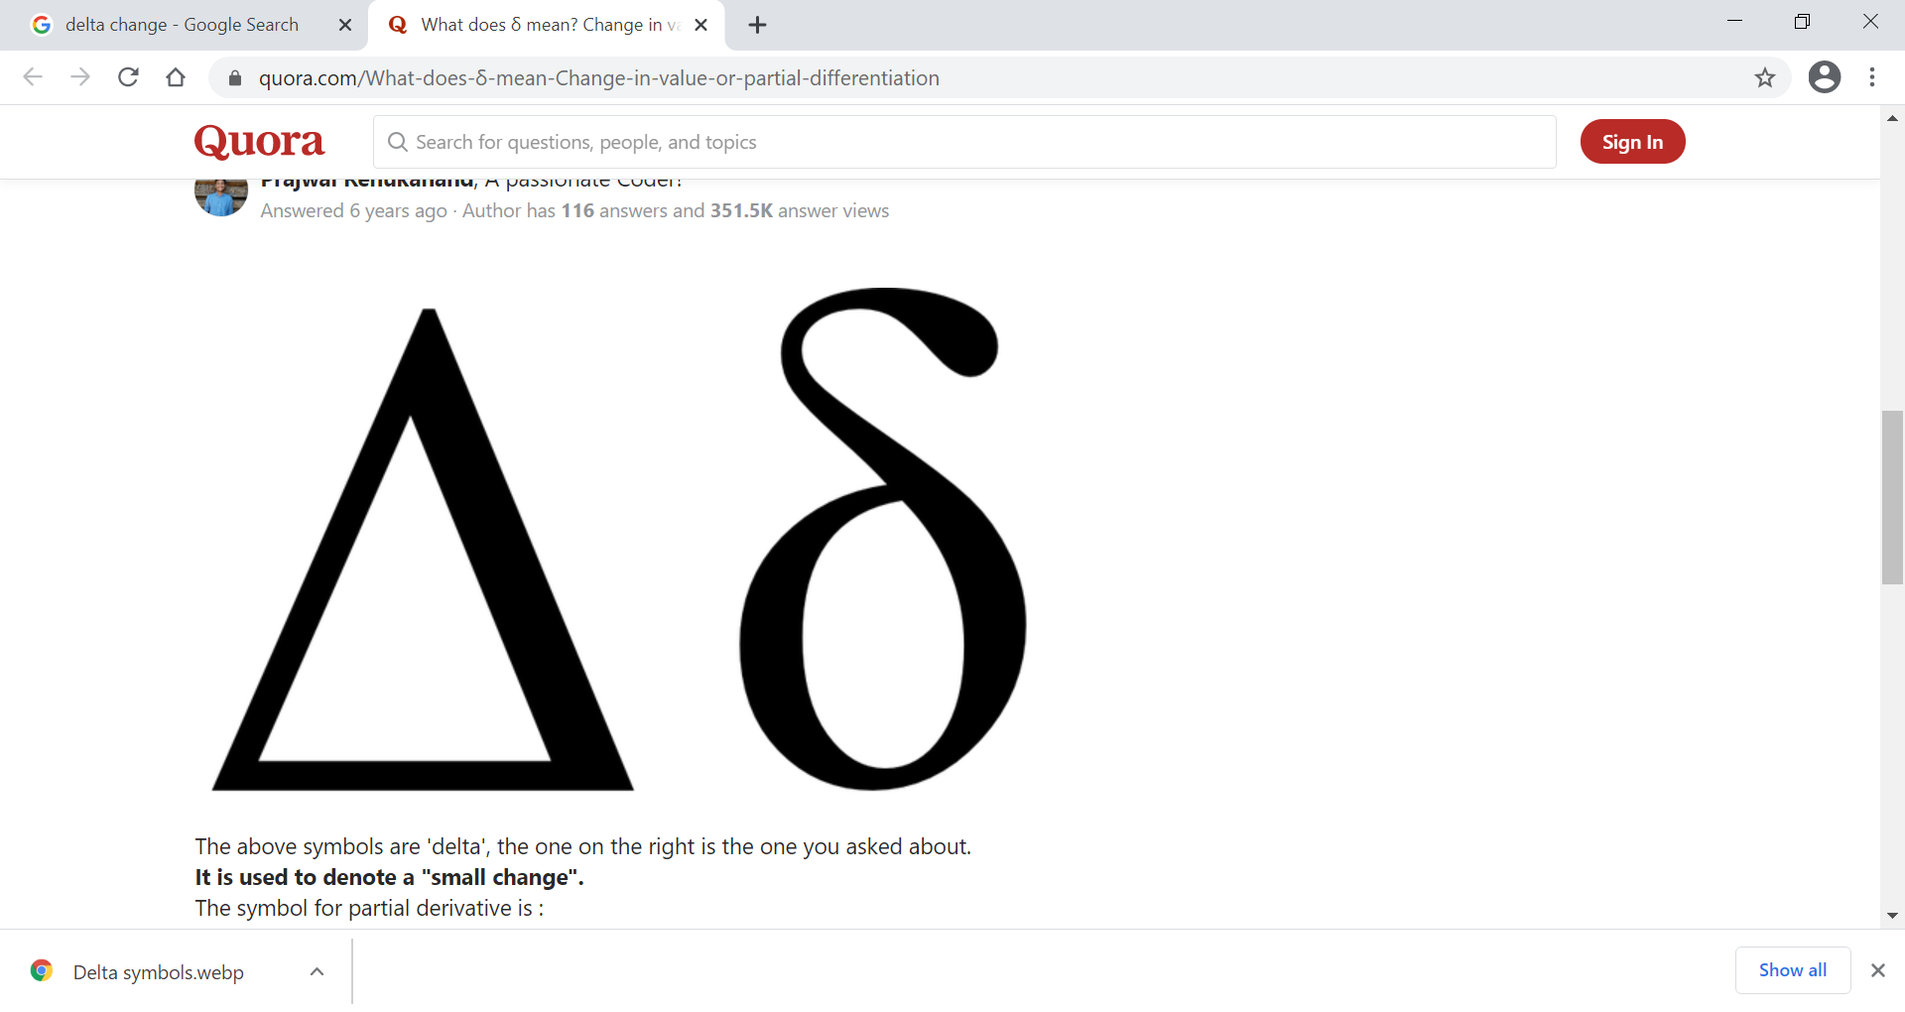
DΔnamic δoil Properties (DSP) January 26, 2020 Olympia Train, PI 12 Michael Robotham, Ph.D. Dynamic Soil Properties (DSP) Business Owner National Soil Scientist
Science-driven - defensible - actionable
January 2021

Slide 2
Dynamic = small, fast changes
Why Dynamic Soil Properties?
Soil properties that change fast with a change in management
A change or delta Δ, can be a measurable environmental benefit
Dynamic Soil Properties (DSP) hub is a high-end geospatial soil data scientist workbench with supporting data reference libraries
Tool for Soil Data Scientists to transform existing NRCS data assets and models into authoritative soil analytics products

Slide 3


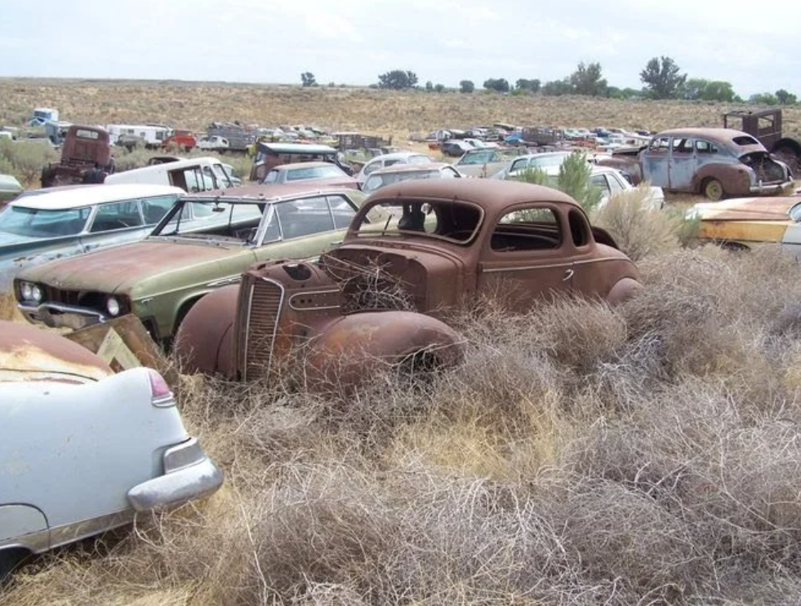
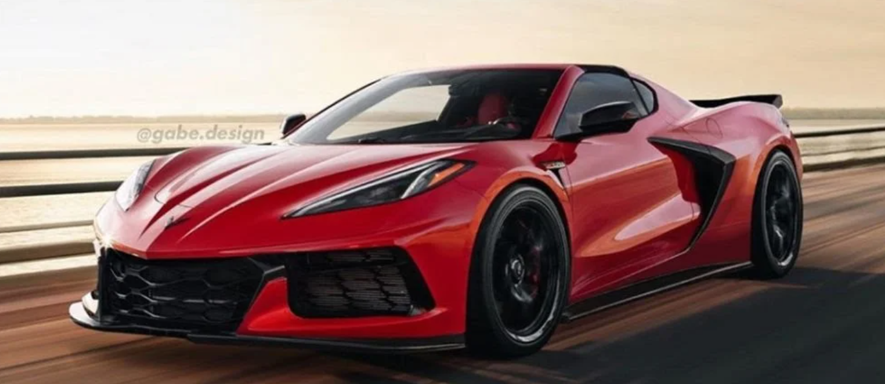
Great tools deliver value
High-end workbench with versatile tools
Organized libraries for models and analytics
Skunkworks (Soil) Bench
Future expansion?
Economists Bench
Water Bench
Carbon Bench

Slide 4
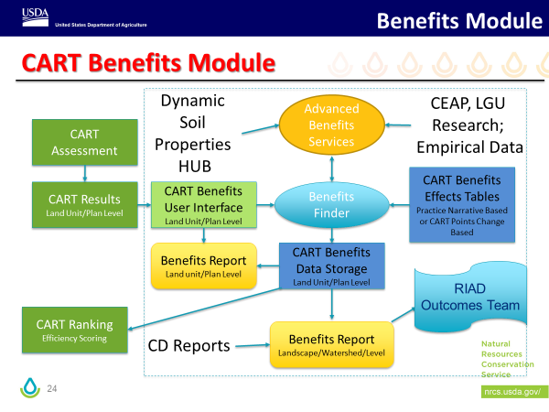
Program Outcomes/Environmental Benefits
DSP Hub as initial design for “Advanced Benefits Services”
Develop requirements for soil-related Environmental Benefits data development
Establish efficient workflow for cross-Deputy Area review process
Dependencies

Slide 5
Agile Approach
Fine-tune business and IT processes, standards, and roles to scale up
Soil Carbon outcomes
Soil Health SHAPE Interp
Automate workflow
zRoles structure
Add data scientists
Currently in PI 1
Upcoming PI – learn and adapt, document draft processes and product requirements to scale up. Establish initial data libraries.

